Slide 1
What you should have written into your reference tables, and make sure you understand what it all means.
Get a new copy, and carefully redo your new one for the second half of the year.

Slide 2
Page 1
Under table A
101.3 kPa = 1.0 atm = 760 mm Hg = 14.7 psi

Slide 3
Page 2
Next to table E Never change the names of the polyatomic ions

Slide 4
Page 2
In Table F
Which solutions are AQ or form precipitates S
AQ
S
S
AQ

Slide 5
Page 3
To the right of table G
Under the curve = unsaturated
On the curve = saturated
Above the curve = impossible

Slide 6
Page 4
Above table H
“behind the curve” = liquid “on the curve” = boiling point (condensing point)
“in front of curve” = gas
High Vapor pressure means weak IMF (easy evaporation) Lower VP = stronger IMF (weaker evaporation)

Slide 7
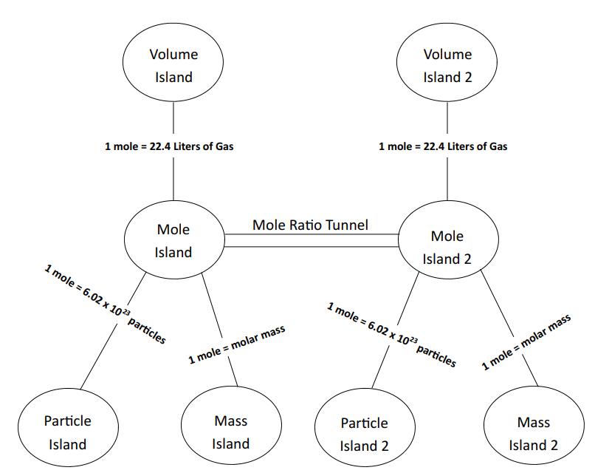
Page 4
Below table H

Slide 8
Page 5
Along side of table I
Reactions 1-6 are combustion
Reactions 7-12 are synthesis (or decomp)
#13 to 18 are solution formation, ionization or dissociation.
For these the ∆H means heat of solution
Last line = dumb

Slide 9
Page 5
Top of table J (for Janet) : Most REACTIVE
Bottom of table J : Least REACTIVE

Slide 10
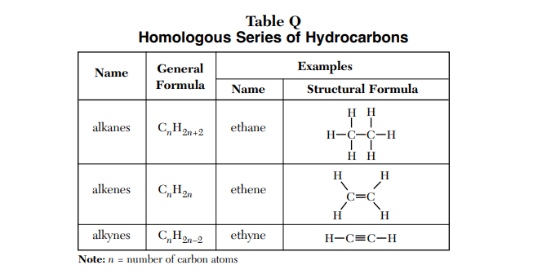
Table Q page 7
saturated
Substitution
unsaturated
Addition
unsaturated
Addition

Slide 11
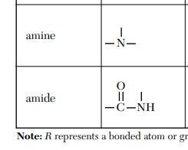
Table R – page 8 Make these small additions…
H
H
H

Slide 12
Table R – page 8 Make these small additions…
̶ CHO
̶ COOH
O
– C – O –
̶ NH₂
O
– C – NH₂

Slide 13
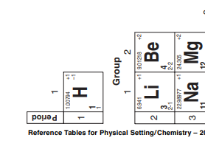
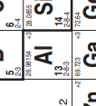
On Periodic Table
+1
+3
+2
All group 1 atoms form only +1 cations
All group 2 atoms form only +2 cations
Aluminum forms only +3 cations

Slide 14
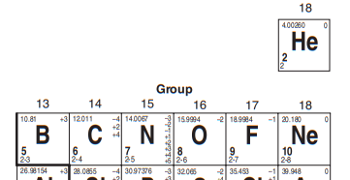
On Periodic Table
Group 13 and 14 make NO ions in high school chem
Group 15 makes only -3 anions
Group 16 makes only -2 anions
Group 17 makes only -1 anions
Group 18 does not make ANY ions
X
-3
-2
-1
X

Slide 15
On Periodic Table Many transitional metals make more than one cation, they get named with roman numerals.
Put a tiny RN into these boxes… atom numbers
22, 23, 24, 25, 26, 27, 28, 29, 32 41, 43, 46, 50, 51 75, 76, 77, 78, 79, 80, 81, 82, 82, 84
Under period 7 : I, II, III, IV, V, VI, VII

Slide 16
On Periodic Table
Names on PT: group 1 = alkali metals
group 2 = alkaline earth metals
groups 3-12 + metals under the stairs = transitional metals
group 17 = halogens
group 18 = noble gases
bottom 2 rows on table are the inner transitional. 22 nonmetals The metalloids = B, Si, Ge, As, Sb, Te, and At.

Slide 17
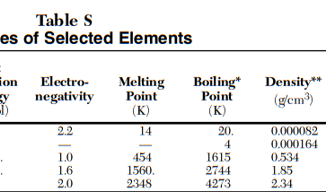
Table S top of page, and again on page 11
SOLID
LIQUID
GAS
Which means you can determine the phase of all elements by creating a temperature line. Where does your temperature fit? Is it below the Melting Point? Is it between the melting and boiling points? Is it above the boiling point?
Note: Melting point temp = Freezing point temp and Boiling point temp = Condensing point temp

Slide 18
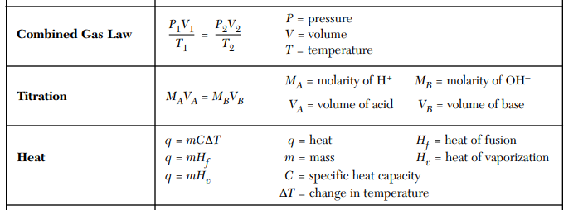
Back Page table T
Any units, consistent
Any units, consistent
Must be KELVIN
(#H⁺¹)(M_{A})(V_{A}) = (M_{B})(V_{B})(#OH⁻¹)
All change temp
in Joules
Cold phase change
in grams
Hot phase change

